Slide 1

Preparing for HDR launch

Slide 2
Ultra HD Forum Master Class: Preparing for the HDR launch
16:30 Forum Update – Ben Schwarz & Thierry Fautier, Ultra HD Forum
16:40 HDR spotlight
  SKY Germany HDR trials - Stephan Heimbecher, Sky Germany
  SKY PerfecTV! HDR commercial launch - Akira Shimazu, SKY Perfect Jsat
16:55 KPN on IPTV 4K launch with Euro’16 – Kristel van Grinsven, KPN
17:05 Guidelines Deep Dive – Madeleine Noland, LG; Chair, Guidelines WG
17:30 DVB and ATSC UHD updates – David Wood, EBU; Skip Pizzi, NAB
17:55 Panel/Q&A – Speakers + Matthew Goldman, Ericsson; moderated by Pat Griffis (Ultra HD Forum)
18:25 Summary, Conclusions, Next steps – Thierry Fautier, Ultra HD Forum
18:30 Close

Slide 3
Thanks to our sponsors for tonight’s party
Gold
Silver

Slide 4
Ultra HD Forum Update
Thierry Fautier
VP Video Strategy at Harmonic, Inc.
Ultra HD Forum President

Slide 5
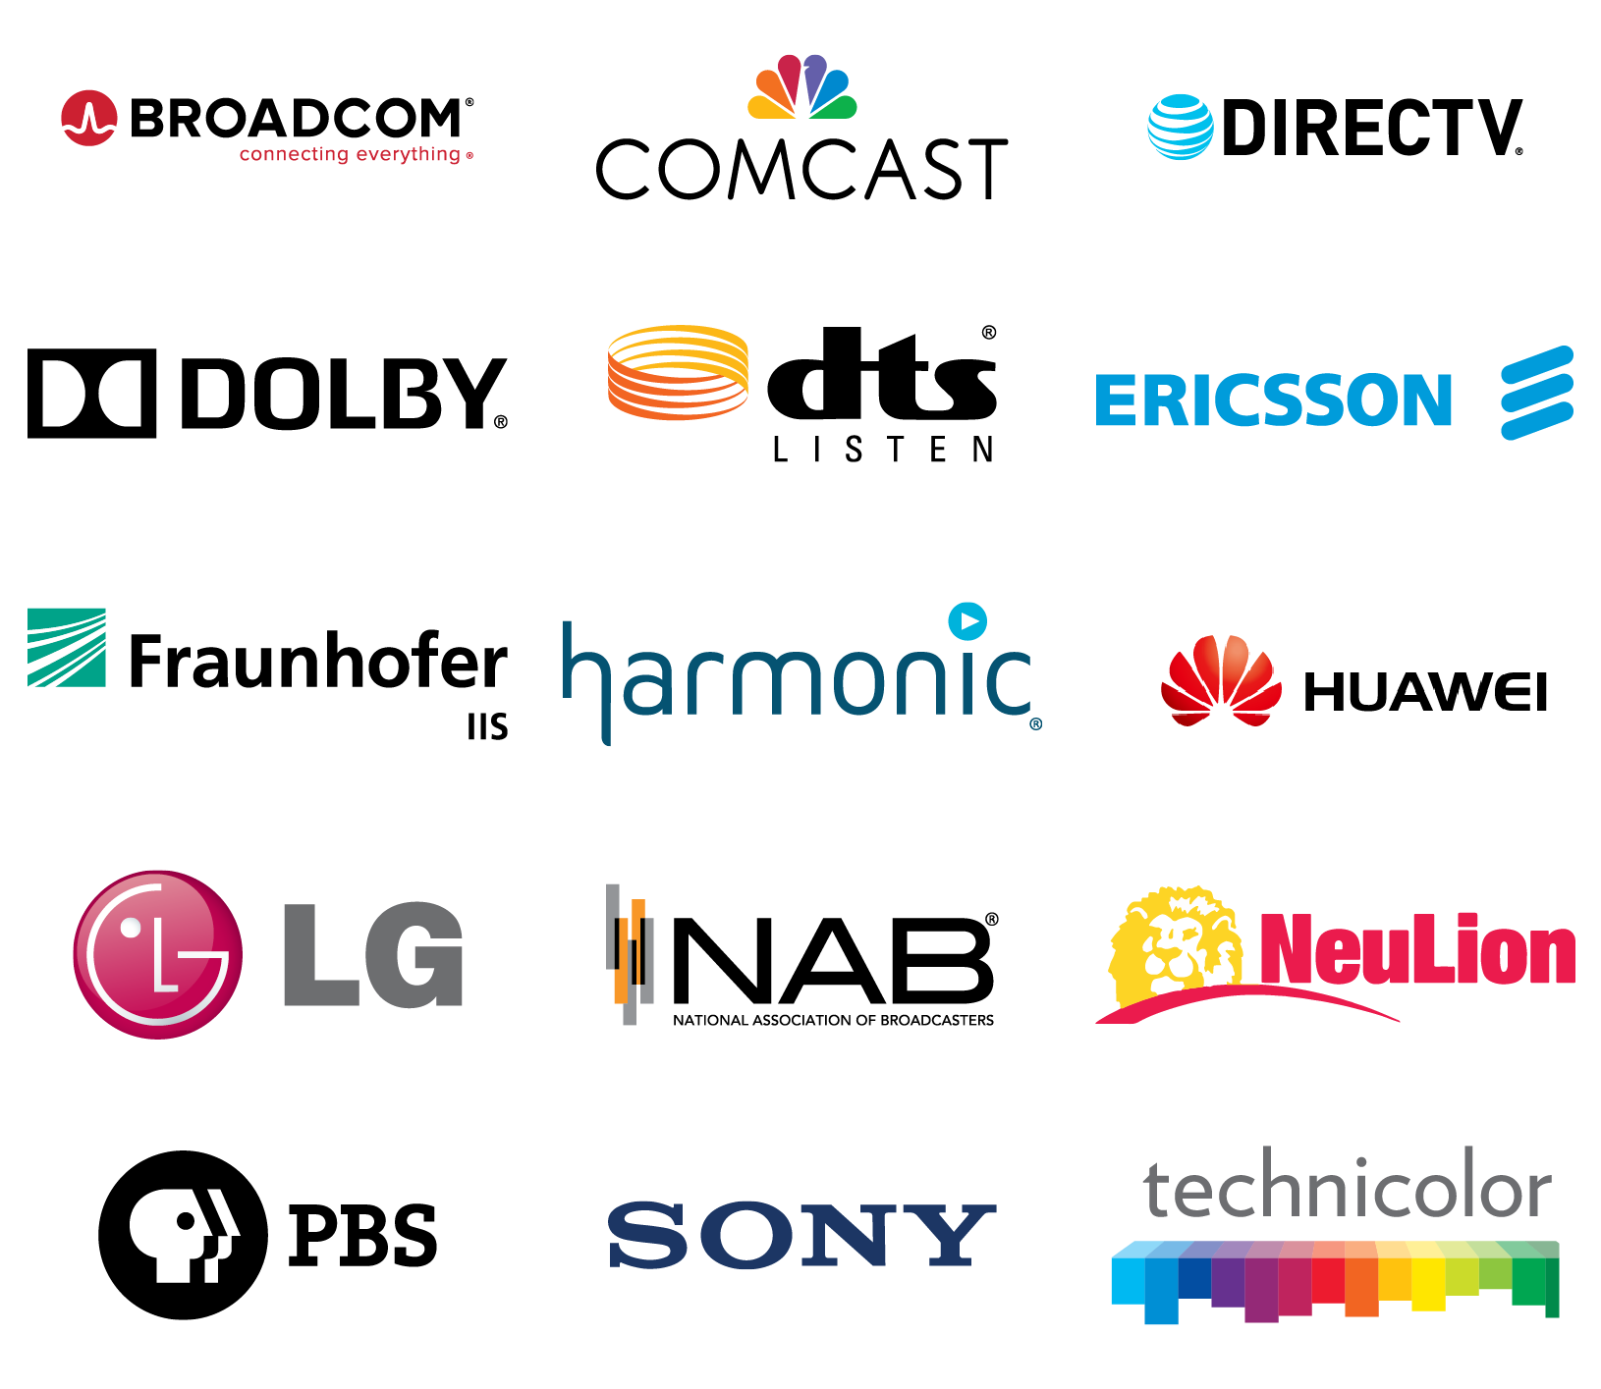
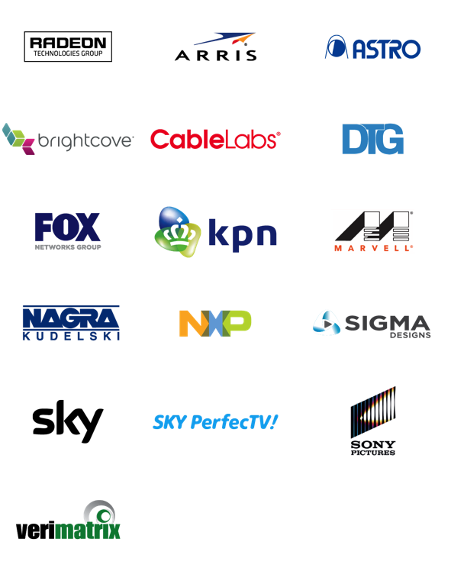
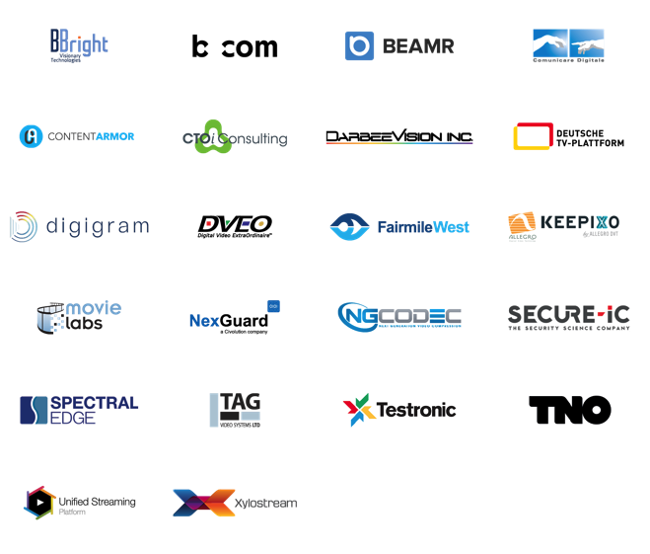
End-to-end advocacy for
next generation A/V delivery
15 CHARTER MEMBERS
16 CONTRIBUTORS
23 ASSOCIATES

Slide 6
Working Groups
Guidelines
Interop
Comms
Liaison
Security
Chair
Madeleine Noland, LG
William Frantz
Neulion
David Price Ericsson
Pat Griffis
Dolby
Laurent Piron
Nagra
Co-Chair
Don Eklund
Sony
Renard Jenkins PBS
Craig Knudsen Dolby
Nandhu
Nandhakumar, LG

Slide 7
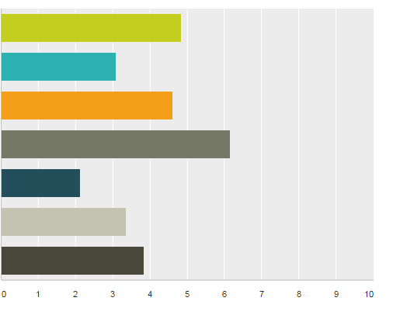
Survey: What’s Important in UHD
4K Resolution
Next-Gen Audio
WCG
HDR
New EOTF
HFR > 60 fps
Screen Size
Phase A
Phase B
n=52
Notes:
Survey was amongst Ultra HD Forum members, so technically savvy people.

Slide 8
Ultra HD Forum’s Relevance
OTT/Media
UHD Alliance & proprietary formats
Live
Specific requirements
SDO
SMPTE, MPEG, ATSC, DVB: Entropy keeps increasing
Ultra HD Forum
We aim to reduce entropy with a pragmatic approach and a 2016 service-provider focus
Good Signs
Aligned with ITU’s New Rec. BT.2100

Slide 9


Operator Members’ Deployments
DATE | OPERATOR | HDR | AUDIO | STATUS
May ’16 |  | SDR | 5.1 | Commercial service
June ’16 |  | SDR | 5.1 | Commercial service
May ’16 |  | SDR | 5.1 | Commercial service
June ’16 |  | SDR | 5.1 | Friendly
Aug ’16 |  | SDR/HDR10 | 5.1/Atmos | Friendly/Public
Aug ’16 |  | SDR | 5.1 | Commercial service
Aug ’16 |  | SDR/HDR10 | 5.1/Atmos | Commercial service
Oct ’16 |  | HLG | 5.1 | Commercial service

Slide 10



HDR/NGA Deployments
EVENT | OPERATOR | HDR | AUDIO | STATUS
May ’15 |  | HLG | 5.1 | Public demo
Aug ’15 |  | HDR10/HLG | 5.1 | Private trial
Nov ’15 |  | HLG | 5.1 | Public trial
April ’16 |  | HDR10 | 5.1 | Private trial
Roland Garros ’16 |  | HLG | 5.1 | Public trial
May ’16 |  | HLG | 5.1 | Private trial
Euro ’16 |  | SDR | 5.1/Atmos | Commercial service
Rio Olympics ’16 |  | HDR10 | 5.1/Atmos | Commercial service
October ’16 |  | HLG10 | 5.1 | Commercial service

Slide 11
Stephan Heimbecher
Director Standards & Innovations, Technology
Sky Deutschland
Live Multi-camera Ultra HD HDR trial

Slide 12
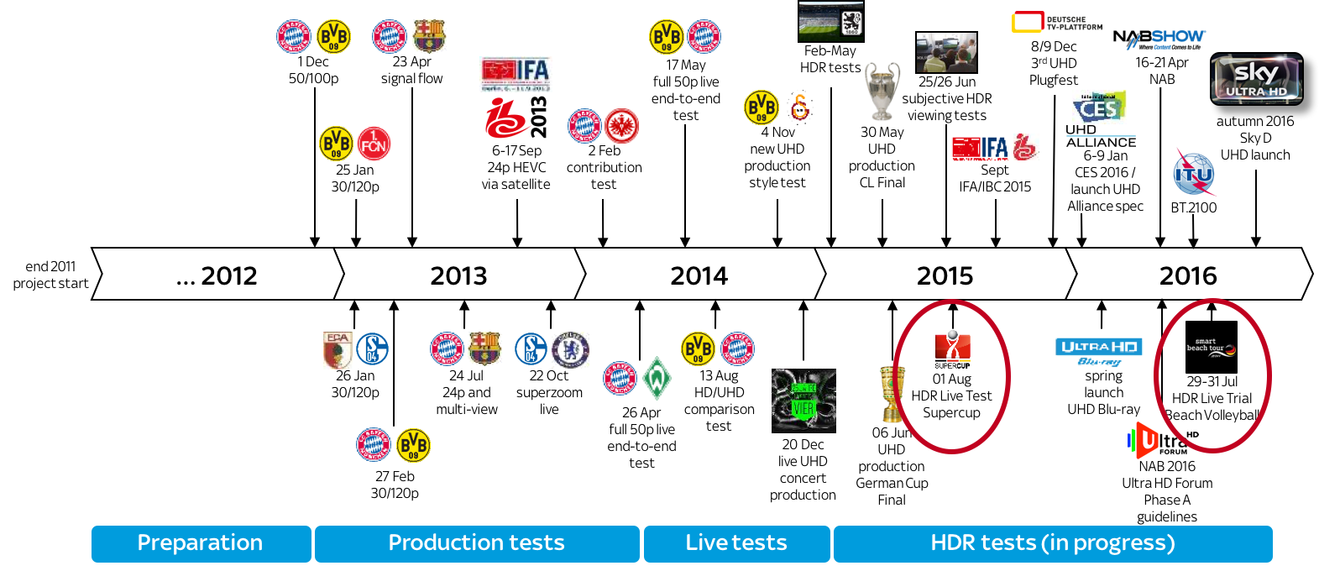
Sky D high-level UHD test roadmap

Slide 13
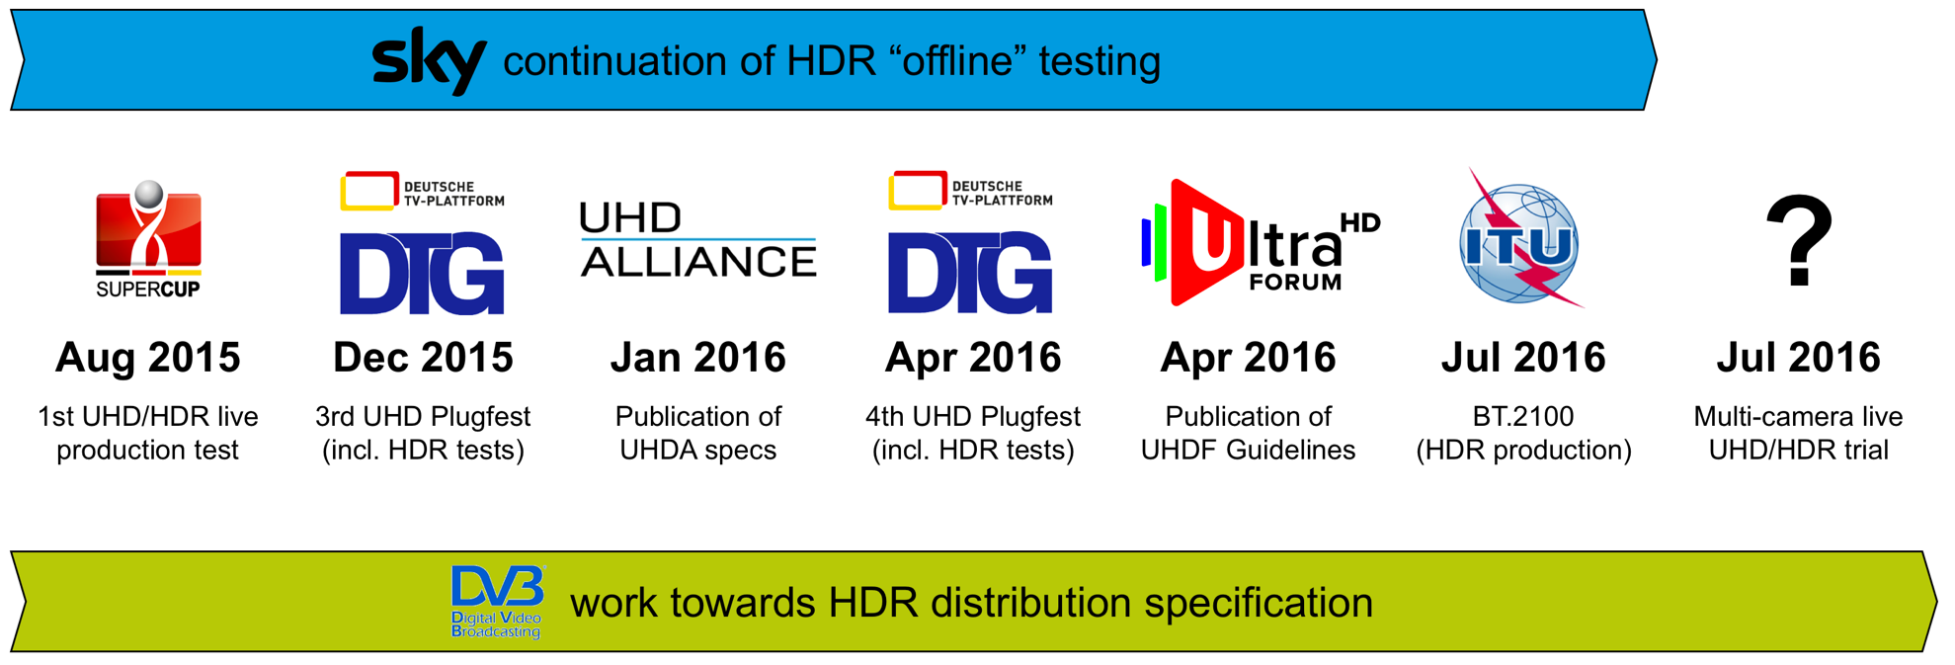
Road to multi-camera HDR trial

Slide 14


Beach volleyball chosen for HDR trial
29-31 Jul 2016
Sankt Peter-Ording

Slide 15
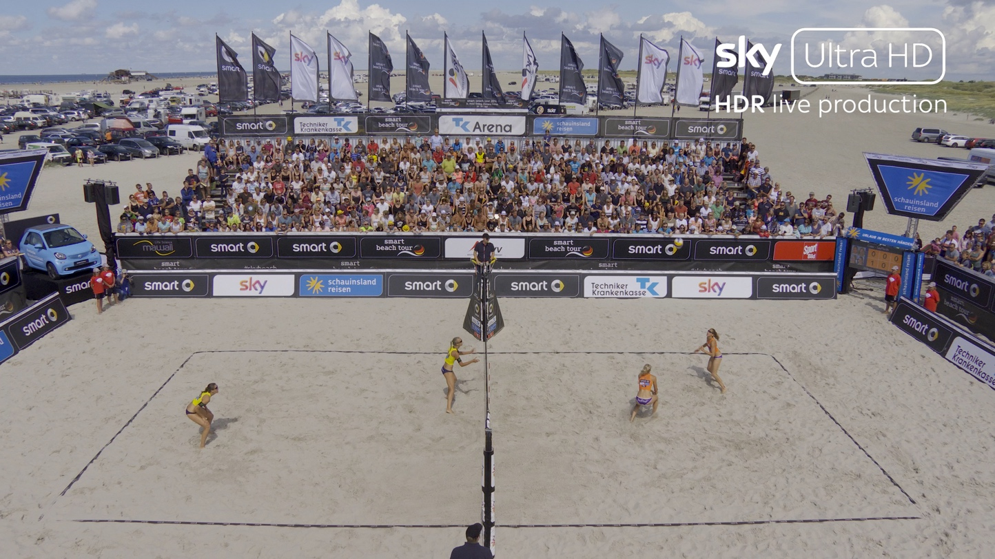
Beach volleyball chosen for HDR trial
29-31 Jul 2016
Sankt Peter-Ording

Slide 16
High-level goals and motivation
demonstrate HDR live production flow, especially racking/shading
multi-camera approach with different angles with respect to sunlight
demonstrate graphics overlay/interstitial material etc.
demonstrate combining UHD HDR and HD SDR content in a live production
Most of this could be achieved during the 3-day beach volleyball trial in St. Peter-Ording (29-31 July 2016):
the absence of any official/commercial (HD) production allowed for complete freedom on site to run as many tests/experiments as possible
the length of the event allowed for maximum possibility to run in-depth testing including repetitive test scenarios during different weather/light conditions
the beach location provided for a challenging HDR setting

Slide 17
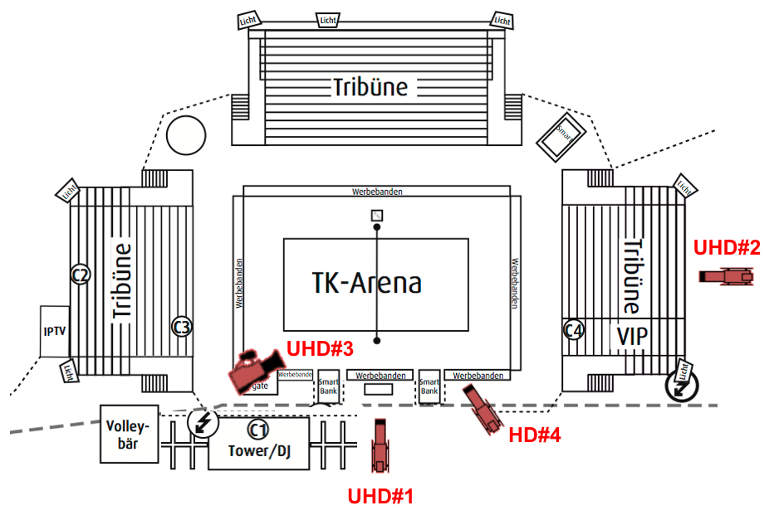
Camera plan
Camera – UHD#1
Sony HDC-4300
27x Canon HD box lens
on separate aerial work platform (ca. 6 m high)
Camera – UHD#2
Sony HDC-4300
95x Canon HD box lens
on platform (ca. 6 m high) behind right grandstand (sea view)
Camera – UHD#3
Sony F55
Canon 17-120 mm 4K lens
handheld camera on floor level
Camera – HD#4
Sony HDC-2500
22x Canon HDxs zoom lens
right corner on floor level

Slide 18
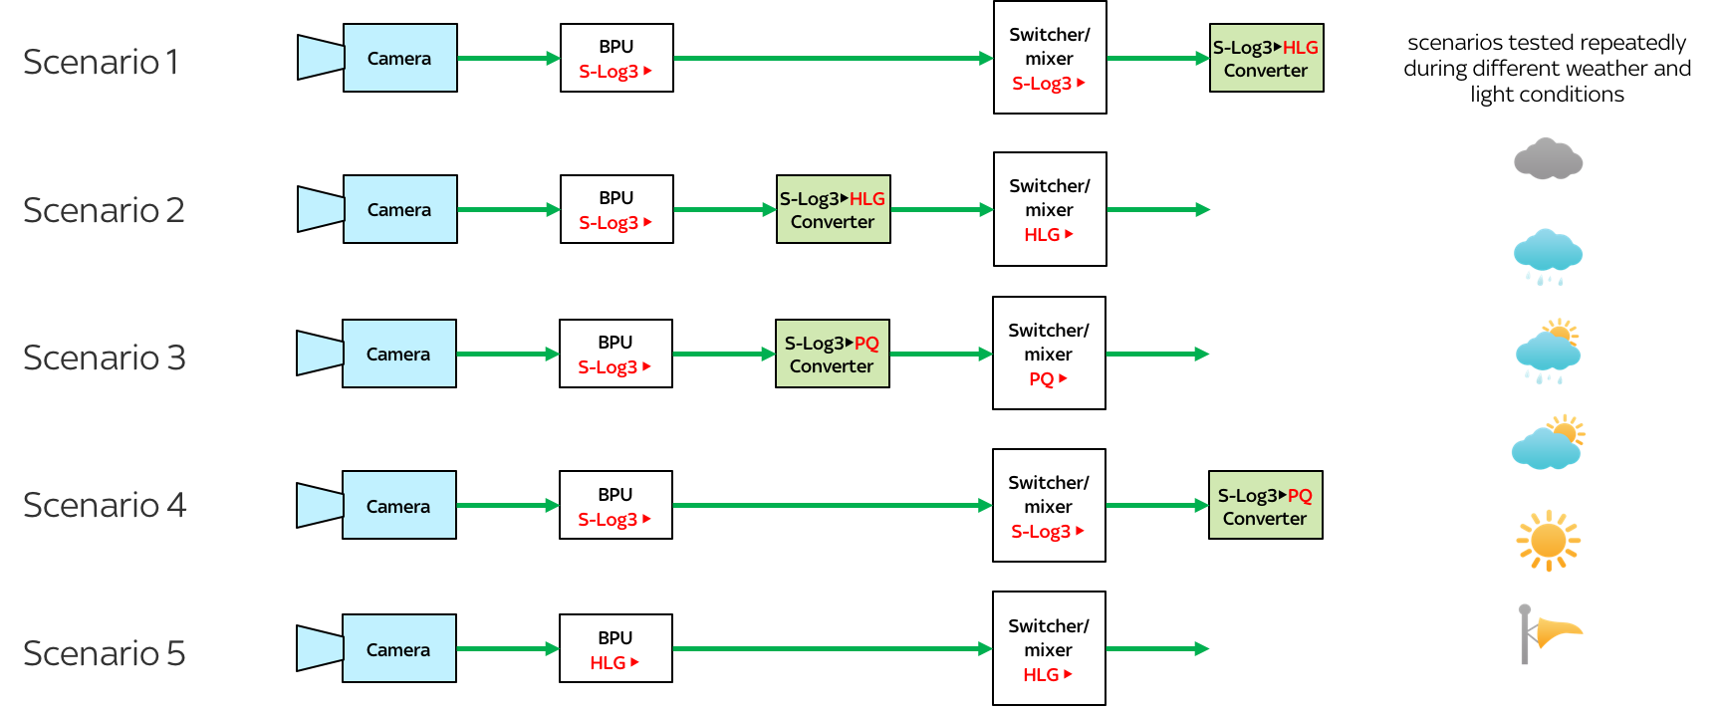
Simplified test approach

Slide 19
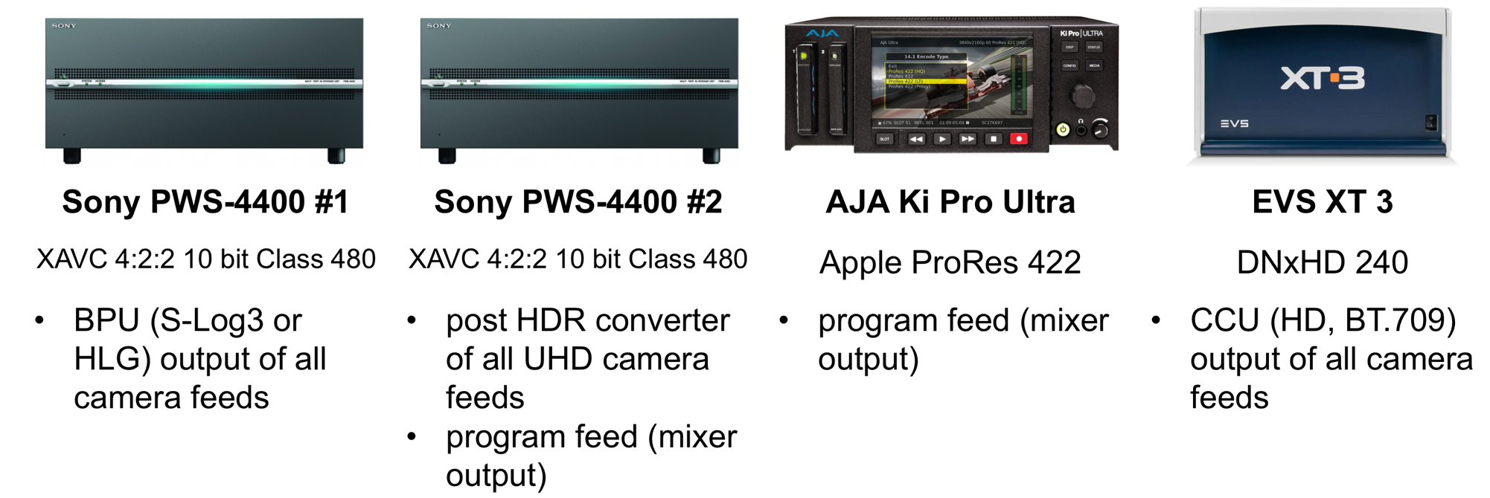
Recording for later evaluation

Slide 20
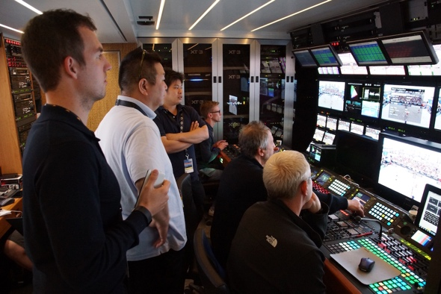
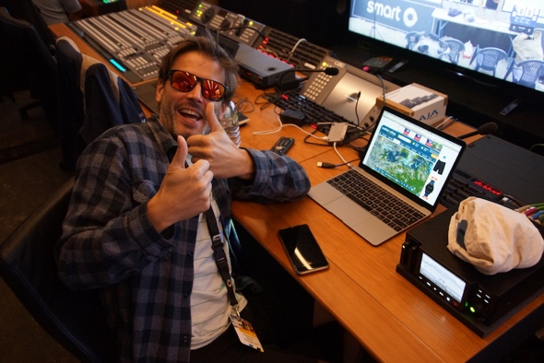
Initial results & findings (1)
Racking guidelines (for simultaneous UHD HDR & HD SDR workflow)
run initial camera setup to correctly expose for HDR
determine the negative gain offset (”SDR gain”) by making sure that SDR looks right
depends on weather/light situation and balance of the scene
continue racking in SDR (CCU’s BT.709 output)
fix misalignment of HDR and SDR by adjusting the individual back level controls
1
2
3
4

Slide 21
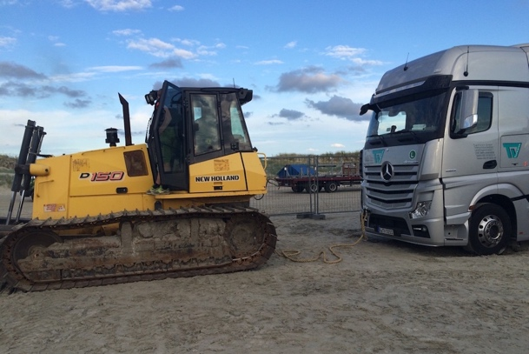
Initial results & findings (2)
Overall HDR production (independent of scenario/transfer function used)
changing light situations are challenging, e.g. during temporary cloud coverage
  “HDR wow” almost more visible in cloudy weather with soft light (e.g. cloud structure)
integration of (up-res) HD camera feed visible, but manageable
  depending on “SDR gain” and respective settings of the HD camera color converter
focus pulling still demanding in UHD
  however, mainly semi-professional camera man used at this trial
Make sure to bring a
Highly Durable Rope

Slide 22
SKY PerfecTV!
Commercial Launch of
HDR Broadcasting
Akira Shimazu
SKY Perfect JSAT

Slide 23

Benefit of HDR
In addition to HDR effect, HDR enhances all other factors for reality
HDR best utilize 10bit tone
10bit depth
60P
HDR enhances finer resolution image
4K
HDR reproduces color of highlight
BT2020
Wide color
ＨＤＲ
Currently broadcasting
three 4K channels with all 4K/10bit/BT2020/60P

Slide 24
Effective Programs of HDR
  Outdoor sport (half shadow football field)
  Music live (laser, spotlight)
  Drama (sunset scene)
  Movie (explosion scene, person/hair)
  Motor sports (the pits of racing, material feeling of car)
  Nature (high contrast scene, snow/ski)
  City (reflection, window, aerial shot of night city)
  Theater play (person & clothes under spotlight)
Tested all scene with HLG, and HDR was very effective.

Slide 25
Reasons to select HLG
HLG is made by broadcaster for broadcasting.
HLG is made to fully utilize camera capability (1300%) and TV capability (1000nits), and optimized code value allocation to it.
HLG is ITU-R standard and ARIB Japanese standard.
HLG has backward compatibility, which allows mixed programming with conventional SDR programs.
Tested various aspect of HLG and PQ, and are comfortable to use HLG for broadcasting. (next page)
SKY Perfect will use HLG for all HDR programming, including movies.

Slide 26
Confirmed items before the decision to start HDR with HLG
Live production work flow
Simul-production work flow of 4K HDR and HD SDR
Test broadcast using current 4K playout system
and current 4K channel
HDR effect on various shooting objects
Movie conversion accuracy from PQ master to HLG
HEVC encoding quality and cost
HDMI implementation (CTA standard will be reflected)
Worked with TV makers on HLG picture quality
Minor modification of system with limited investment

Slide 27
Live HDR workflow
- S-Log3 and HLG centric production workflow -
Live shooting
Editing & OB van
Output
Broadcast master
4K/HLG
BT.2020
HLG
4K/HDR channel
PWM-F55
（RAW）
S-Log3/ or HLG BT2020
Live Simul-feed
HDC-4300
BPU
Conv.
HD/SDR
BT.709
SDR
HD/SDR channel
（ S-Log3/S-gamut3 ）
One system
C300
Conv.
（C-Log2）
Conv
Conv
Disc master
S-Log3/
BT.2020
PQ
BT.709
HDR
Monitoring
SDR
Monitoring
Conv.
（709）
（SDR/BT.709）
Various sources
（HLG/BT.2020）
Off line
Various outputs
for camera control and QC

Slide 28
Movie conversion to HLG
Converted PQ to HLG, using formula defined by ITU HLG standard
16bit master
Broadcast master
4K
PQ / Peak 1,000nit
Tiff16bit
Movie & test clips
Master
PQ Master/Tiff
PQ 10bit Master/XAVC
Conversion by formula
using Mistika preset
Picture comparison
on two X300 monitors
HLG Master/Tiff
HLG 10bit Master/XAVC
[Result]
Jointly tested with Hollywood studios, and had a consensus on the
accuracy of conversion. Some studios verified by themselves and
had same conclusion.
[Conclusion]
HLG can be used for movie distribution, if converted from more than
10bit PQ master with right tool.

Slide 29
HEVC encoding quality and cost
Distribution
<Picture result>
16bit master
10bit broadcast
master
HEVC 12M
Need encoder optimization for PQ to reduce noise/contour (different setting from SDR)
Master
HEVC 15M
PQ /Tiff 16bit
PQ / XAVC
HEVC 35M
Conversion
by large LUT
HEVC 100M
=> Good quality
HEVC 12M
No major break of picture even 12Mbps
HLG / Tiff 16bit
HLG / XAVC
HEVC 15M
HEVC 35M
=> Good quality for broadcasting
[Conclusion]
Current 35Mbps of 4K/SDR is good enough for HDR/HLG.
For broadcasting, HLG is more economical and simpler, as HLG case, one playout encoder per channel covers mixed HLG and SDR programming.

Slide 30
July 29, 2016 News Release
SKY PerfecTV! Dedicated 4K Channel
Adopted the Hybrid Log-Gamma (HLG) standard,
Begin the World’s First*¹ 4K HDR Broadcast in October
SKY Perfect JSAT Corporation (Head Office: Minato-ku, Tokyo; Representative Director, President & Chief
Executive Officer: Shinji Takada) will commence the world’s first 4K HDR (High Dynamic Range) broadcast
on October 4, 2016, during timeslots on its dedicated 4K channel “SKY PerfecTV! 4K Experience” (launched
on May 1, 2016). This channel can be enjoyed free of charge by anyone with the necessary environment for
receiving the SKY PerfecTV! Premium Service or SKY PerfecTV! Premium HIKARI Service.
In commemoration of the commencement of 4K HDR broadcasts, a program jointly produced with the Imagica
Robot Group will air in 4K HDR along with all five episodes of the BS SKY PerfecTV! Original drama “Kera
(Yakubyo-gami Series)” (starring Kazuki Kitamura and Gaku Hamada).
4K HDR broadcasts have a wider dynamic range, particularly in the expression of the contrast between light and dark imagery, and enable even more true-to-life depictions. For its 4K HDR broadcasts, SKY Perfect JSAT adopted the Hybrid Log-Gamma (HLG) standard, which was co-developed by the public broadcasters NHK (Japan Broadcasting Corporation) and BBC (British Broadcasting Corporation). Moreover, while there is a variety of HDR techniques, HLG was developed as the most suitable format for broadcasting and HLG became an international standard in July this year. ……

Slide 31
HDR broadcast plan
Major expansion
Launch
May 2016~
Spring 2017
Oct 2016~
４K Experience
HDR
HDR experience
for sub & non-sub
March 2015~
４K General
HDR
４K Movie
HDR
4K / SDR / BT2020 / 60P / 35Mbps HEVC
HDR(HLG) / SDR mixed programming in all 4K channels

Slide 32

Example of HDR programs
Original Drama “Kera”
Other programs
Travel series: “My favorite place”
Food series: “Midnight chocolatier”
Documentary: Projection mapping
event
Nature program: National park
(Wyoming / Yellowstone)
Ⓒ 2016 SKY Perfect JSAT

Slide 33
Preparation for HLG launch as an industry
In addition to the preparation of SKY Perfect, industry partners are also preparing for HLG.
4K HDR TV
Toshiba and Sony have announced to upgrade 4KTV with SKY Perfect
4K tuner, to HLG capable. Other TV makers are also working on update.
Monitors
In addition to Sony X300 & Canon monitors and Astrodesign waveform
monitor, more to come at IBC.
Editing equipment
MISTIKA already has HLG capability, and other NLE makers are planning
to prepare update for HLG.

Slide 34
KPN Feedback from IPTV 4K launch with Euro’16
Kristel van Grinsven
KPN Projectmanager TV & Media
iTV Innovatie

Slide 35
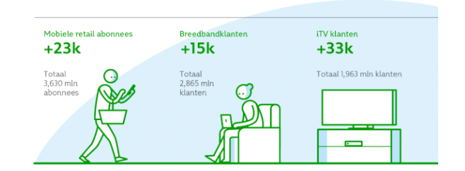
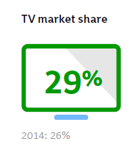
Key figures KPN – Q2 2016
Mobile retail subscribers
Broadband customers
iTV customers
YE 2015
Total
3.630 mln
subscribers
Total
2.865 mln
customers
Total 1.963 mln customers

Slide 36
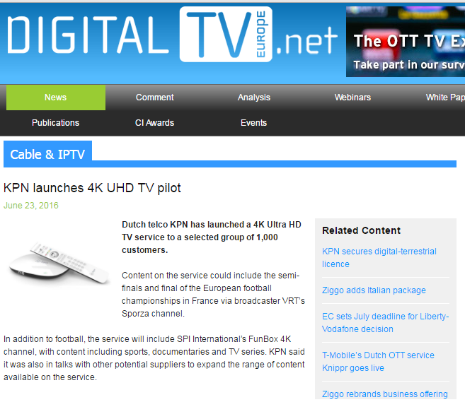
KPN launches UHD 4K package
Roll out strategy
Launch on June 21
    KPN press release
    DM campaign
Excellent customer response:
    40% has opened the mail
    25% has clicked through
Customer registration to join the pilot on the 4K plaza on KPN.com
Within couple of days the total of 1.000 pilot customers was reached

Slide 37
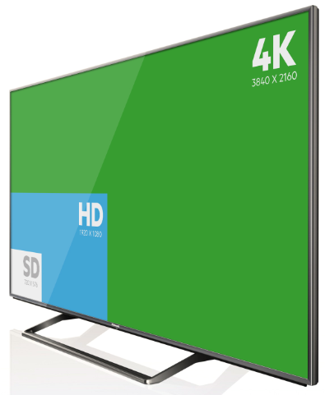
Why:
Offer the best TV-experience
“We want to offer our customers always the best TV experience, that is why we are rolling this out step by step to our customers.
Through the introduction of 4K Ultra HD TV, we make TV watching more fun and easier and offer our customers superior user experience”
Bas van Vlierden, Director TV KPN.

Slide 38







What do we offer?
EK 2016 semi finals and final in 4K
Linear Channels
Video on Demand
Channel 690
Channel 691

Slide 39
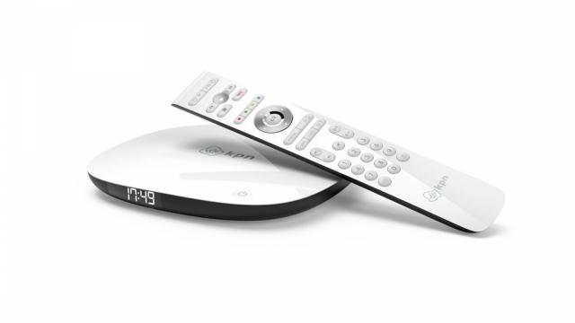

New Set Top Box 4K Ultra HD TV
Selected for the prestigious reddot design award 2016!
•Modern and premium design
•The TV receiver as well as the remote control are backward compatible
•Remote control with bluetooth. Possibility to put the receiver out of sight

Slide 40
Customer responses
Feedback of the pilot customers:
Very impressed of the quality, the enormously sharp, bright and smooth images of the 4K UHD streams
Fading objects when objects are fast moving on the screen
  Artefacts with moving objects are different for the different types of screens, further investigations are needed
Purple coloured screens occurring on certain TV’s in combination with KPN’s 4K STB (HDMI related)
Missing possibility of recording on the UHD 4K channels
  The 4K service of KPN started with live TV only. Meanwhile this has been activated for all users, along with network pause live TV and Start over TV.
Wish for more 4K content

Slide 41
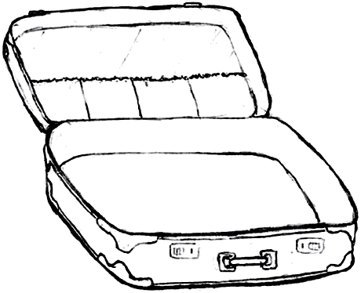

Next steps
STB
4K

Slide 42


Next steps
STB
4K
HDR
Single layer
Colour space
Rec 2020

Slide 43

Next steps
STB
4K
HDR
Single layer
Colour space
immersive
audio
Need for stable specs!
Rec 2020
22.1

Slide 44
Forum Guidelines for Phase A
Madeleine Noland
LG Electronics
Guidelines Working Group Chair

Slide 45
Ultra HD Forum Phase A Guidelines
Focus on end-to-end work flows for real-time program streams (aka “linear services”)
Live and pre-recorded programming
“On-the-fly” assembly of the service
  Interstitial insertion and graphic overlays at multiple points in the supply chain
Phase A = 2016
  Technologies and procedures that can be used in 2016
Phase A linear services are likely to be delivered via MVPDs and OTT
  OTA broadcast services will commence in 2017 in Korea

Slide 46
UHD Phase A – Definition
Spatial Resolution | 1080p* or 2160p
Color Space | BT.709, BT.2020
Bit Depth | 10-bit
Dynamic Range | SDR, PQ, HLG
Frame Rate** | 24, 25, 30, 50, 60
Distribution Video Codec | HEVC, Main 10, Level 5.1
Audio Format | Stereo, 5.1, channel-based immersive audio
Audio Codec | AC-3, EAC-3, HE-ACC, AAC-LC
Captions/Subs Coding (in/out formats) | CTA-608/708, ETSI 300 743, ETSI 300 472, SCTE-27, IMSC1
*1080p together with WCG and HDR fulfills certain use cases for UHD Phase A services and is therefore considered to be an Ultra HD format for the purposes of these guidelines. 1080p without WCG or HDR is considered to be an HD format. The possibility of 1080i or 720p plus HDR and WCG are not considered here. HDR and WCG for multiscreen resolutions may be considered in the future.
**Fractional frame rates for 24, 30 and 60 fps are included, but not preferred. Lower frame rates may be best applied to cinematic content.

Slide 47
ITU-R BT.709, BT.2020, BT.2100
 | BT.709 | BT.2020 | BT.2100
Spatial resolution | HD | UHD, 8k | HD, UHD, 8k
Framerates (integer & fractional) | 24, 25, 30, 50, 60 | 24, 25, 30, 50, 60, 120 | 24, 25, 30, 50, 60, 120
Interlace/Progressive | Interlace, Progressive | Progressive | Progressive
Color Space | BT.709 | BT.2020 | BT.2020
Dynamic Range | SDR (BT.1886) | SDR (BT.1886) | HDR (PQ, HLG)
Bit Depth | 8, 10 | 10, 12 | 10, 12
Color representation | RGB, YCbCr | RGB, YCbCr | RGB, YCbCr, ICtCp
Phase A Guidelines uses BT.709 and BT.2020 as Color Space references.

Slide 48
UHD Phase A – HDR and WCG
HDR Transfer functions in Phase A :
  PQ
  HLG
HDR “Packages” in Phase A:
  PQ10* PQ EOTF, BT.2020 color gamut,10-bit depth
  HLG10* HLG OETF, BT.2020 color gamut, 10-bit depth
  HDR10 PQ EOTF, BT.2020 color gamut,10-bit depth
  plus metadata: SMPTE ST 2086, MaxFALL, MaxCLL
*Ultra HD Forum terms

Slide 49
Signaling PQ10 & HLG10 in HEVC
HEVC Main10 Profile bitstream elements |  | PQ10 | HLG10 (HLG in VUI) | HLG10 (HLG in SEI)
VUI | Colour_primaries | 9 (BT.2020) | 9 (BT.2020) | 9 (BT.2020)
 | transfer_characteristics | 16 (PQ) | 18 (HLG) | 14 (SDR)
 | matrix_coeffs | 9 (Y’CbCr) | 9 (Y’CbCr) | 9 (Y’CbCr)
SEI | alternative_transfer_characteristics preferred_transfer_characteristics | Not present | Not present | 18 (HLG)
 | mastering_display_volume (ST 2086) | Optional | N/A | N/A
 | content_light_level_info (MaxCLL/FALL) | Optional | N/A | N/A

Slide 50
Signaling & Format Changes
Currently, Dynamic Range and Color Space cannot be signaled in SDI – SMPTE is working on this
Encoders can be set up to insert Dynamic Range and Color Space in HEVC output
  Changes in dynamic range and/or color space “on the fly” during a linear program service may not be feasible in Phase A
  Encoders operating in real-time may not be able to receive and implement a format change instantly
Downstream decoders may not process a format change seamlessly

Slide 51
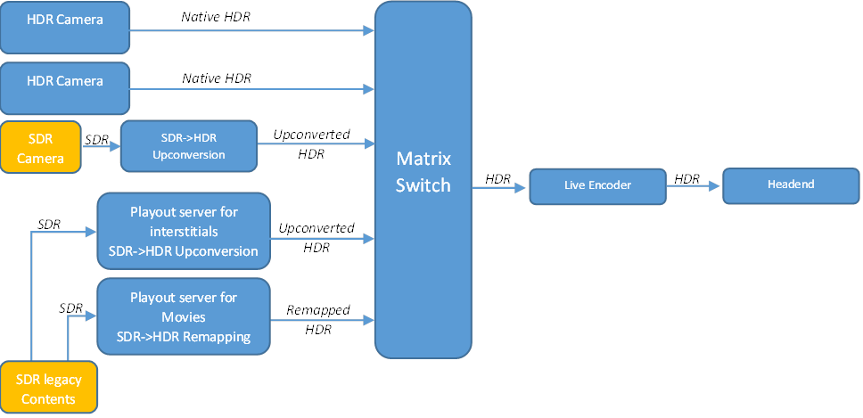
Mixing HDR with SDR

Slide 52
SDR<>HDR and PQ<>HLG
Normalizing content in a linear service to one “house format” is recommended in Phase A
  All program segments, interstitials, and graphic overlays comprising the linear service inserted at all points in the chain
3D LUTs are currently the de facto method
  New information about “reference white” levels in conversions are emerging, e.g., 75IRE for HLG
  Other methods such as SL-HDR1 are emerging for HDR->SDR conversions

Slide 53

Distribution Chain
Guidelines covers the following at each point in the chain:
  compression technologies
  metadata carriage options
  audio, captions and subtitles
  content manipulation: ad insertion, graphic overlays, etc.
  sample bitrate ranges

Slide 54

Signaling/Metadata Carriage
Care needs to be taken at each decode/re-encode point in the chain since the signaling is “lost” at decode
The transfer function and color space must reach the display for a reasonable picture

Slide 55
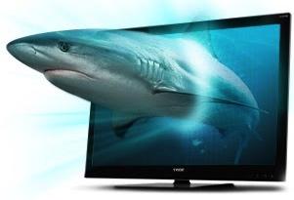
Decoding & Rendering
UHD displays handle 2160p resolutions, but may not be capable of HDR or WCG
  UHD SDR/BT.709
  UHD HDR/BT.709
  And there are HD SDR/BT.709 displays, too
Backward compatibility for SDR and BT.709 cases discussed

Slide 56
Decoder/Display Architectures
Integrated decoder/display for OTT services
  Easiest case, since HDMI is not a factor and OTT can offer different streams for different devices
Separate decoder/display (STB-Display) for MVPDs
  Not all Ultra HD parameters are carried over HDMI 2.0a
  STBs may provide some conversion capabilities for backward compatibility

Slide 57
Backward Compatibility
Options include
  Down-conversion at Production
  Down-conversion at the Service Provider
    Simulcast or unicast
  Down-conversion at the STB
    HDMI “hand-shake” to discover display capabilities
  Spatial up-conversion of HD/SDR/BT.709 content in the UHD device
Interoperability of channel-based immersive audio
  Atmos using E-AC-3 includes a 5.1 feed for legacy devices

Slide 58
But Wait…
There’s More!
Ultra HD Forum Guidelines is a “living document”
Revisions are constantly underway as technology develops and matures and service providers work with new techniques
Schedule is TBA – goal is to keep pace with the fast-changing industry

Slide 59
HDR: Can DVB Come up with the Goods?
David Wood
EBU

Slide 60
DVB Starting Gate
The HDR story in the ITU-R. New Recommendation for HDR for Programme Production and Exchange: BT 2100 (to add to BT 2020)
Recommends two forms of HDR. They are essentially two new relationships between volts and light to allow a higher dynamic range.
HLG (Hybrid Log Gamma aka the Happy London Gentlemen)
PQ (Perceptual Quantizer aka the Palo alto Quasher).
Explaining the relative advantages of each is a real whoop-de-doo!
DVB defines commercially attractive profiles for broadcast and broadband drawing on existing standards, usually ITU-R and ITU-T/MPEG.

Slide 61
DVB and HDR
DVB UHD-1 is a series of specifications in ‘Phases’ to match, over time, the wishes of broadcasters and manufacturers
DVB UHD-1 ‘Phase 1’ was prepared in 2014 to meet the needs of services in 2015 and later. It included only 4K resolution
DVB UHD-1 2A is being prepared now to meet the needs of services in 2017 and later. It includes 4K resolution and HDR
DVB UHD-1 2B is also being prepared now to meet the needs of services in 2019 and later. It includes 4K resolution, HDR, and HFR (Frame Rates up to and including 120 Hz)
DVB UHD-1 2A and 2B specifications should be available later in 2016.
DVB NGA/ASS should be available at the same time as 2A and 2B.

Slide 62
DVB HDR Commercial Requirements
Different markets call for different HDR compatibility solutions.
Both BC (backwards compatible) and NBC (non backwards compatible) HDR options are requested to be included in the spec.
Including both options in receivers is not mandatory.
More details in the DVB Commercial Requirements for UHD-1 Phase 2
Five candidates have been put forward.
Extensive discussions and analysis of characteristics have been made.

Slide 63
Chapter 4: A New Hope!
The TM-AVC group led by Ken (“just a wee dram then!”) McCann are planning to prepare the draft specification for DVB Phase 2, CPA and CPB shortly.
This will then be submitted to the DVB Technical Module (chair Kevin Murray) and DVB Steering Board (chair Peter Mac Avock) for approval by the end of the year.
We Try Harder. DVB will deliver the goods (digits crossed).
P.S. Don’t forget about the value of NGA!

Slide 64

ATSC 3.0 UHD Update
Skip Pizzi, NAB
Member, Ultra HD Forum Board of Directors
ATSC TG3 Vice-chair

Slide 65
Overall ATSC 3.0 Status
ATSC 3.0 is a suite of ~20 separate Standards, organized in 3 layers
Physical Layer is mostly Final or Proposed Standards
Management & Protocols Layer mostly at Proposed or Candidate Standards
Applications & Presentation Layer is mostly at Working Drafts or Candidate Standards

Slide 66
ATSC 3.0 Layered Structure

Slide 67
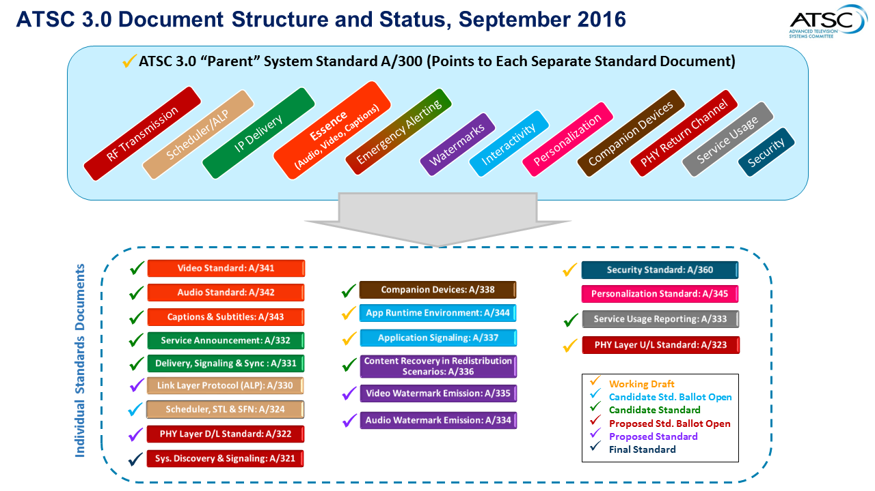

Slide 68
ATSC 3.0 UHD Status
A/341 Video (HEVC) Candidate Standard*
  Uses HEVC Main10 profile, up to 2160p
  Currently has TBDs for other HDR elements, HFR
  Numerous HDR proposals under consideration
  CBS-NY hosted comparative HDR demos in June
Broadcasters may rely on 1080p+HDR/WCG
  Especially during transition period
  HEVC encoder optimization required for this approach
A/342 Audio Candidate Standard*
  Provides Immersive & Personalizable sound
  Objects & Channels (11.1 req’d., 22.2 opt.) req’d., Scene-based opt.
  Supports AC4 and MPEG-H 3D audio systems
  * Subject to Change

Slide 69
Panel/Q&A Session
Pat Griffis, Moderator | Dolby Laboratories
Matthew Goldman | Ericsson
Skip Pizzi | NAB
Stephan Heimbecher | Sky Deutschland
Madeleine Noland | LG Electronics
Kristel van Grinsven | KPN
Akira Shimazu, | Jsat

Slide 70
Conclusion and What’s Next
Thierry Fautier
VP Video Strategy at Harmonic, Inc.
Ultra HD Forum President

Slide 71
What is Next?
NGA
Object-based coding, Immersive, Interactive
Scalable coding
Dual layer, backward compatible
Video fidelity
Greater than 10 bits, IC_{T}C_{P} color space, …
HFR
p100/120 fps
HDR
Dynamic metadata, backward compatible

Slide 72
Thanks to our sponsors for tonight’s party
Gold
Silver

Slide 73
Thank You for your highly dynamic attention!
www.ultrahdforum.org

